Slide 1

HTML Table

Slide 2
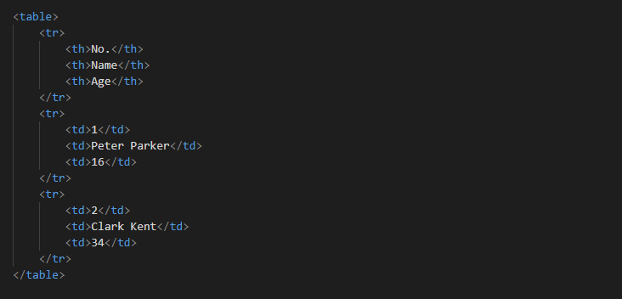
Creating Tables in HTML
HTML table allows you to arrange data into rows and columns.
You can create a table using the <table> element. Inside the <table> element, you can use the <tr> elements to create rows, and to create columns inside a row you can use the <td> elements. You can also define a cell as a header for a group of table cells using the <th> element.

Slide 3
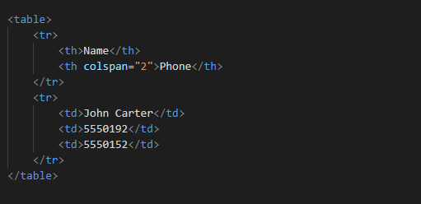
Spanning Multiple Rows and Columns
Spanning allow you to extend table rows and columns across multiple other rows and columns.Normally, a table cell cannot pass over into the space below or above another table cell. But, you can use the rowspan or colspan attributes to span multiple rows or columns in a table.
Let's try out the following example to understand how colspan basically works:

Slide 4
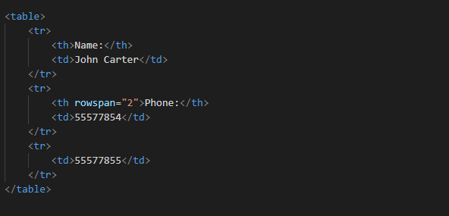
Similarly, you can use the rowspan attribute to create a cell that spans more than one row. Let's try out an example to understand how row spanning basically works:

Slide 5
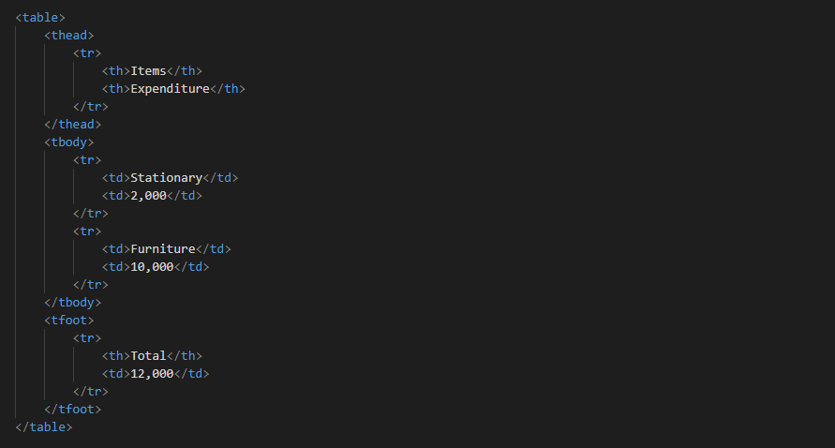
Defining a Table Header, Body, and Footer
HTML provides a series of tags <thead>, <tbody>, and <tfoot> that helps you to create more structured table, by defining header, body and footer regions, respectively.

Slide 6
Notes:
In HTML5, the <tfoot> element can be placed either before or after the <tbody> and <tr> elements, but must appear after any <caption>, <colgroup>, and <thead> elements.
Do not use any style or tag in between <tr> tag. Add content only in <td> tag.

